Slide 1
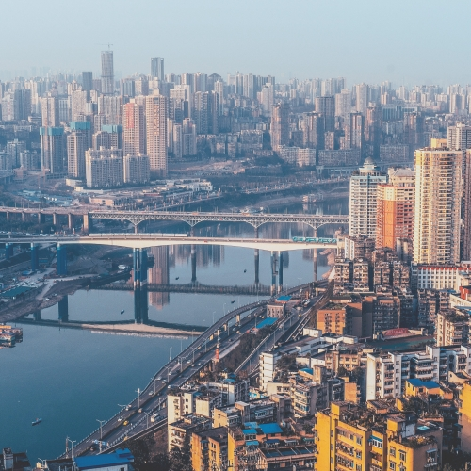
“Urbanocene” or the Urban Anthropocene?
Myint (2018): a transformation from the Anthropocene to the Urbanocene
Lussault (2020): Anthropocene as the Urbanocene; a spectacular evolution of the earth system, with urbanization as a primary driver
“Part of story of the anthropogenesis of humans is the story of the species’ urbanization: anthropogenesis is urbanogenesis” (Mendieta, 2019: 93).
Notes:
In her article on ‘The long read: From the Anthropocene to the Urbanocene: Understanding Asia’s rural out-migration and global climate change’, Tua Myint argues that global climate change is driven by individual behaviours of consumption and life-style dynamics, which are intensified at the local level. And she emphasized that the changes in individual consumption behaviours and life-styles from the rural to urban are driving the local/global extraction of materials from the planet. Compiling robust datasets on rural out-migration to urban areas within the Asian context, Myint says that the world has encountered a transformation from the Anthropocene to the Urbanocene.
M. Lussault – https://riverlab.berkeley.edu/index.php/2019/03/could-the-anthropocene-be-an-urbanocene/
https://steemit.com/education/@fugetaboutit/the-anthropocene-an-urban-city-perspective:
Urban Agency and the Anthropocene
Steffen et al. (2015) date the start of the Anthropocene to the beginning of the Great Acceleration, and among their indicators of the latter, “one of the most important trends of all is the rapid rate of urbanization” (89). Similarly, Zalasiewicz et al. (2015) note that the number of mega-cities has risen from 2 to 25 since 1945, and that these will be “evident strati-graphically in the distant future.” (198) In other words: in light of the Great Acceleration, the city makes up a big part of what is now called the Anthropocene; urbanization is an indicator of its current amplitude and forms one of its future geographical proofs.

Slide 2
The ‘new’ urban / The urban moment
2007 – the urban population of the world surpassed the rural population (World Urbanization Prospects, 2008)
1950 – 30%; 2018 – 55%; BY 2050 – 68% (World Urbanization Prospects, 2018).
Evident in the:
  Rate
  Scale
  Shifting geographies of urbanization
Notes:
an unprecedented mega-urbanization of humanity since the last 200 years (Mendieta, 2019)

Slide 3
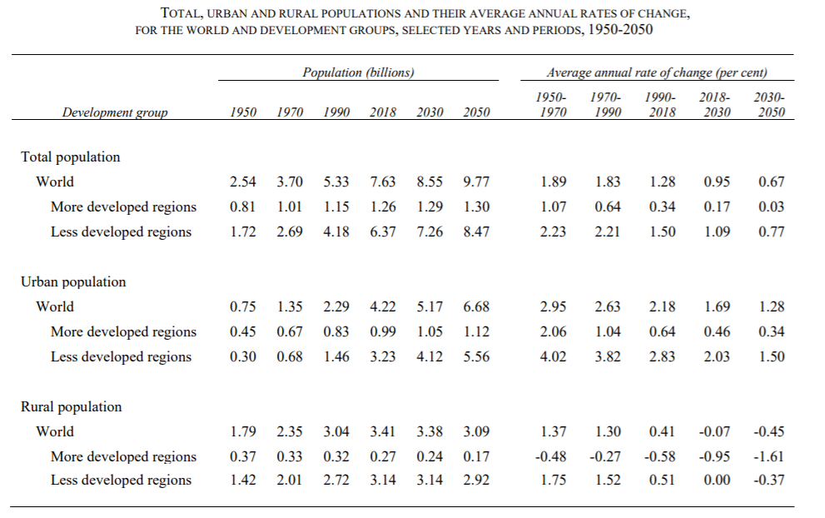
Rate
"clock speed" of cities (Myint, 2018)
1959 – one billion
1985 – two billion
2002 – three billion
2015 – four billion
2028 – five billion
2041 – six billion
Notes:
The global urban population first reached 1 billion in 1959. It took 26 years to grow to 2 billion in 1985, another 17 years to reach 3 billion in 2002, and just 13 years to add the fourth billion in 2015. Urban population growth is expected to continue, such that the urban population of the world will reach 5 billion in 2028 and 6 billion in 2041. (World Urbanization Prospects, 2018).
Tua Myint: Several fascinating sections investigate the increasing "clock speed" of cities, where time itself is accelerating — to the point where their metabolisms, economics and politics are increasingly out of sync with nature and with less-urbanized regions. The implication is that we either work out how to produce almost infinite resources to feed our new appetites, or new technologies and major paradigm shifts must "reset the clock before potential collapse occurs.“

Slide 4
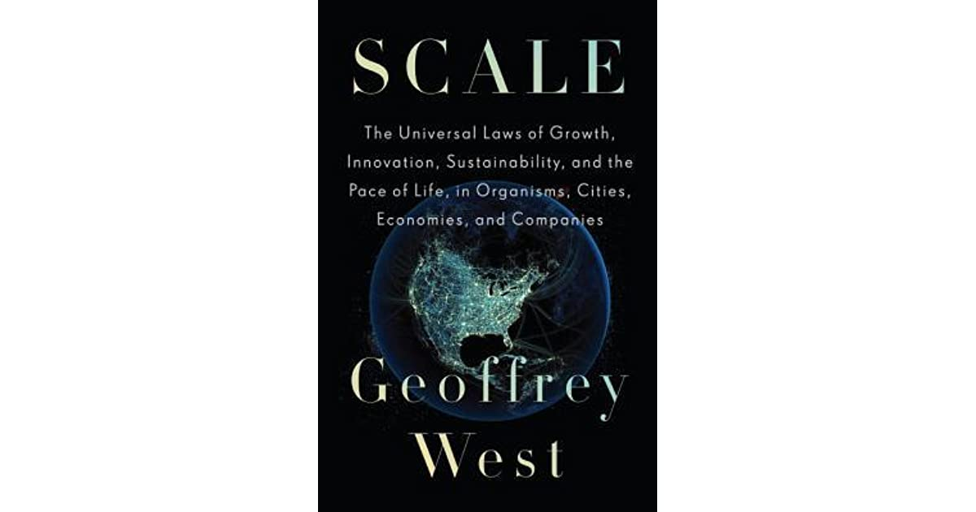
Scale
size (and also numbers) really matters…
cities are bigger than at any other time in terms of their physical extents, population sizes, economic importance, and environmental impacts (Seto et al., 2010)
Number of cities with one million (or >) population
Year | Number of cities
1800s | Beijing
1900s | 16
2000s | 378 (India – 40; China – > 100
2025 | 600
Notes:
Geoffrey West’s paradigm-shifting book, "Scale: The Universal Laws of Life and Death in Organisms, Cities and Companies (2017): coined the term ‘Urbanocene’ – learning our scales, why size really matters.
As the Anthropocene crises from climate change through to the loss of soils and biodiversity bite, so the inadequacy of current solutions will become achingly obvious.
At a time when "most politicians, economists and policy makers take a fairly optimistic view that our ingenuity will triumph," West is less sure, concluding that "everyone will be affected; there is no hiding place.” – what can be a better example than COVID 19 where human race is literally hiding in homes and the homeless remaining exposed to all kinds of challenges with ever sharper intensities.

Slide 5
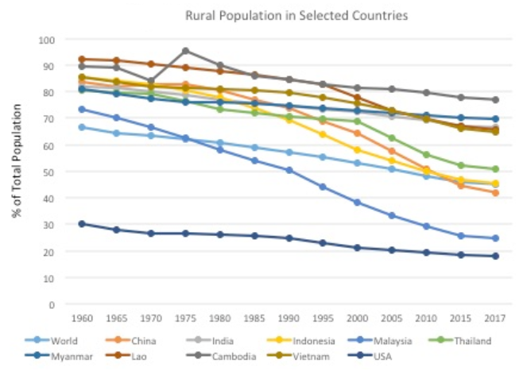
Shifting geographies
The world’s largest internal migration of rural people to urban areas has been happening on a remarkable scale in Asian countries since 1990s.
Between 1990 and 2017 China was the leading rural out-migrating society in the world (falling from 73.56 to 42.04 per cent of the total population), followed by SE Asia
Sharp decline in Thailand’s rural population, from 80% in 1960 to 48.46% cent in 2016
1900 – 2017: Indonesia (from 69.42 to 45.34 per cent) and Malaysia (halving from 50.21 to 24.55 per cent)

Slide 6
By 2030
the urban population in China is expected to exceed one billion, an increase of 400 million, and result in the creation of at least 30 cities of one million
India is projected to surpass that of China, with its urban population nearly doubling from today’s 350 million to 611 million and with an addition of 26 cities of one million
Notes:
The Global South as the new location, mainly: Asia and South America

Slide 7
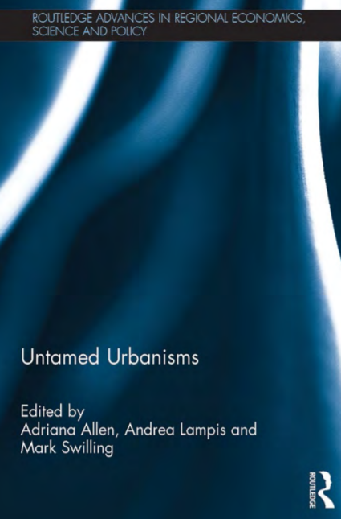
Implications – metabolism to ‘metabolic rift’
consumption and consumerist cities
a largescale, dispersed, fragmented, and (non-)networked landscape – planetary urbanization
…metabolisms, economics and politics are increasingly out of sync with nature and with less-urbanized regions (Myint 2018)
from centric formations to the new polymorphic urban tissue deeply extended in the once rural and natural environment (Novaković & Milaković 2018)
The developing world has already entered into the high-growth, rapidtransition phase of the urbanization process, marked by numerous problems and challenges including the swelling of slums and squatter settlements; lack of citywide infrastructures for services such as housing, health and sanitation; privatization and commercialization of infrastructures; city development plans based on the logic of foreign capital; the widening gap between the rich and the poor; and the changing nature of the rural–urban divide (Mukherjee, 2015: 33).
Notes:
Eduardo Mendieta, Edge City, Critical Philosophy of Race, 2019 – unprecedented mega-urbanization with the largest megalopolises of the 21st c. in the global South – irregular – skyrocketing of ghettos, chawls, shanties, favelas, etc.
Transgression of nine PBs
Disbalance and destabilization of urban-peri-urban dynamics; loss of urban metabolism – from mutually interdependent relationship between the urban and its larger ecological settings to mutually truncated equations

Slide 8
REFERENCES
Lussault, M. 2020. Could the Anthropocene be an “Urbanocene?” Available at: https://riverlab.berkeley.edu/index.php/2019/03/could-the-anthropocene-be-an-urbanocene/
Mendieta, E. 2019. Edge City: Reflections on the Urbanocene and the
Plantatiocene. Critical Philosophy of Race, 7(1): 81-106.
Mukherjee, J. 2015. Sustainable Flows between Kolkata and its Peri-urban Interface: Challenges and Opportunities. In A. Allen, M. Swilling and A. Lampis (eds.) Untamed Urbanisms. UK: Routledge.
Myint, T. 2018. The Long Read: From the Anthropocene to the Urbanocene: Understanding Asia’s Rural out-migration and Global Climate Change. Available at: https://theasiadialogue.com/2018/12/14/from-the-anthropocene-to-the-urbanocene-understanding-asias-rural-out-migration-and-global-climate-change/

Slide 9
Novaković, N. and Milaković, A. 2018. The Scale of the Urban: World Urbanisation and Architectural Reactions. In N. Novaković, J.P. Grom and A. Fikfak (eds.), Realms of Urban Design: Mapping Sustainability. Netherlands: TU Delft.
Seto, K., Sanchez-Rodrıguez, R. and Fragkias, M. 2010. The New Geography of
Contemporary Urbanization and the Environment. The Annual Review of Environment and Resources, 35: 167-94.
West, G. 2017. Scale: The Universal Laws of Life and Death in Organisms, Cities and Companies. UK: Hachette.
United Nations, Department of Economic and Social Affairs, Population Division (2019). World Urbanization Prospects: The 2018 Revision (ST/ESA/SER.A/420). New York: United Nations.

